Slide 1
Overview
Insert Date

Slide 3



EnglishConnect is an English-language-learning program provided by The Church of Jesus Christ of Latter-day Saints.
Its purpose is to help participants expand opportunities by developing English skills in an environment of faith, fellowship, and growth.
Increase faith in
Jesus Christ
Become a more capable learner
Develop English skills

Slide 4

Levels and audiences
EnglishConnect has multiple levels to help learners progress.
EnglishConnect 1 and 2 are free and help learners develop basic English skills.
EnglishConnect 3 is low-cost and prepares learners for workplace and academic opportunities — especially BYU-Pathway Worldwide.
All are invited: ages 11+, members of the Church, and friends of the Church.

Slide 5



Basic Level
Free
Interactive conversation groups
Self-paced practice
Prepare for EnglishConnect 3
Notes:
Program details -
Curriculum: Basic English
Length: 25 lessons per course
Conversation Group: 90-min weekly group led by local members or missionaries (in person or virtual)
Cost: Free
Implementation: Led by stake, coordinating council, mission, or Area, delegated to self-reliance specialist or other assigned committee
Placement: Learners self-select or teacher evaluates using conversation assessment

Slide 6


EnglishConnect 1 and 2: Beginner Resources
Free courses with interactive conversation groups.
Resources available in print, the Gospel Library app, and at englishconnect.org.

Slide 7
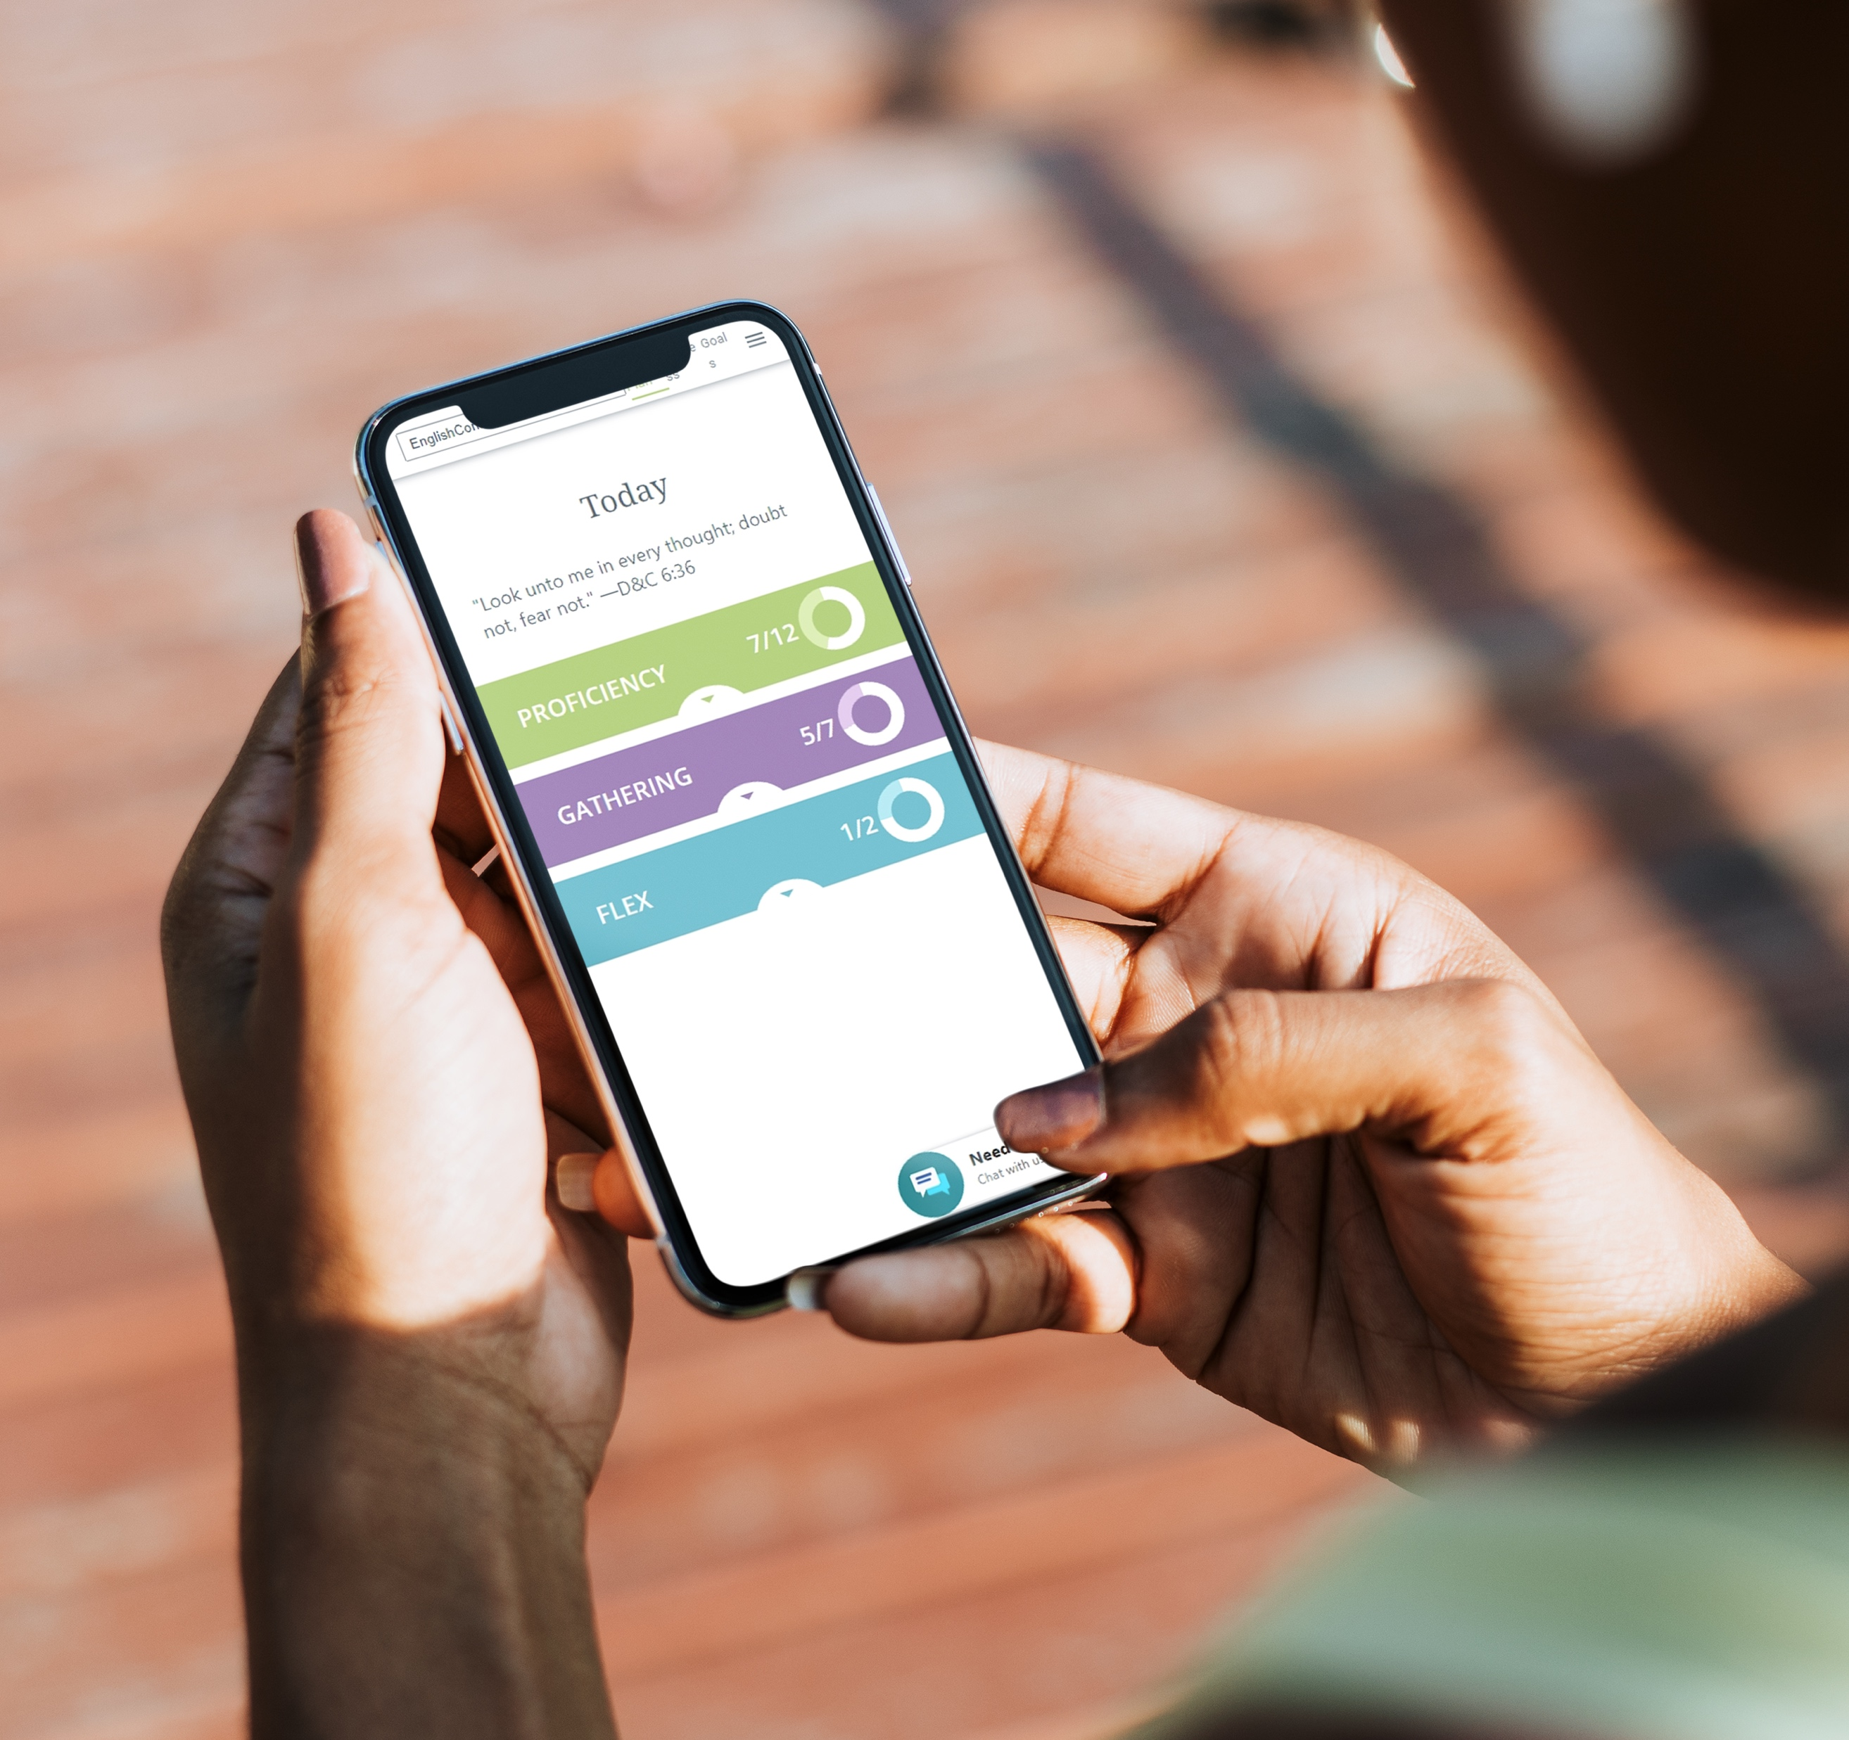

Intermediate level
Low-cost, online
Interactive conversation groups
Self-paced practice
Prepare for university studies, especially BYU-Pathway
Notes:
Program details -
Curriculum: Academic and workplace English
Length: 14 weeks; learners can repeat
Weekly Gathering: 90-min, learner-led, facilitated by BYU-PW missionaries (virtual)
Cost: cost varies by country
Implementation: BYU-PW
Placement: Assessment score

Slide 8

EnglishConnect 3: Intermediate Resources
Low-cost online course
Mobile and laptop friendly online course
Feedback from trainer reviewers
Progress tracking tools
Academic and workplace topics

Slide 9
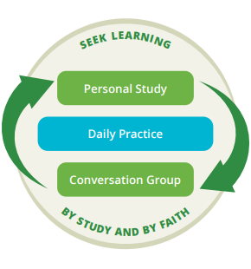
What will you do in EnglishConnect?
Personal study:
Study a spiritual principle of learning
Memorize vocabulary
Practice communication patterns
Conversation groups:
Discuss the principle of learning
Create conversation using communication patterns
Evaluate your progress and prepare for the next week
Daily practice:
Add English to your daily activities
Pray often about how to improve

Slide 10




The EnglishConnect experience
Learn in the unique environment of faith, fellowship, and growth
Spiritual principles
of learning
Interactive conversation groups
Tools to
accelerate learning
Targeted practice
and feedback
Focus on
communication
Notes:
Consider going back to main 3 ?

Slide 11


Seek God's Help to Learn English
Lessons include spiritual principles of learning to help participants partner with God to accomplish their goals.
"It is comforting to speak with people who have the same goal as you, striving to become better together through effort and faith in Jesus Christ."
—Sharlene Recodig
Notes:
Seek learning by study and also by faith. (Add reference)

Slide 12
Principles of Learning
Our Framework: “Seek learning, by study and also by faith” (D&C 88:118)
Believe You Are a
Child of God
Exercise Faith in
Jesus Christ
Take Responsibility
Love and Teach
One Another
Press Forward
Counsel with the Lord
Notes:
Remove details

Slide 13

YOU ARE A CHILD OF GOD
When we understand our true potential, we can partner with God to do things that seem impossible – including learning English.
EXERCISE FAITH IN JESUS CHRIST
Through the grace and power of Jesus Christ, we can receive strength and help to learn and change.
TAKE RESPONSIBILITY
We have the power to choose, and we are responsible for our own learning.

Slide 14

LOVE AND TEACH ONE ANOTHER
As we love, teach, and learn together, we invite God’s help, and our capacity grows.
PRESS FORWARD
Learning a language takes time, effort, and persistence, but God can help us press forward.
COUNSEL WITH THE LORD
As we seek God’s guidance, we can find solutions to our problems and overcome our challenges.

Slide 15
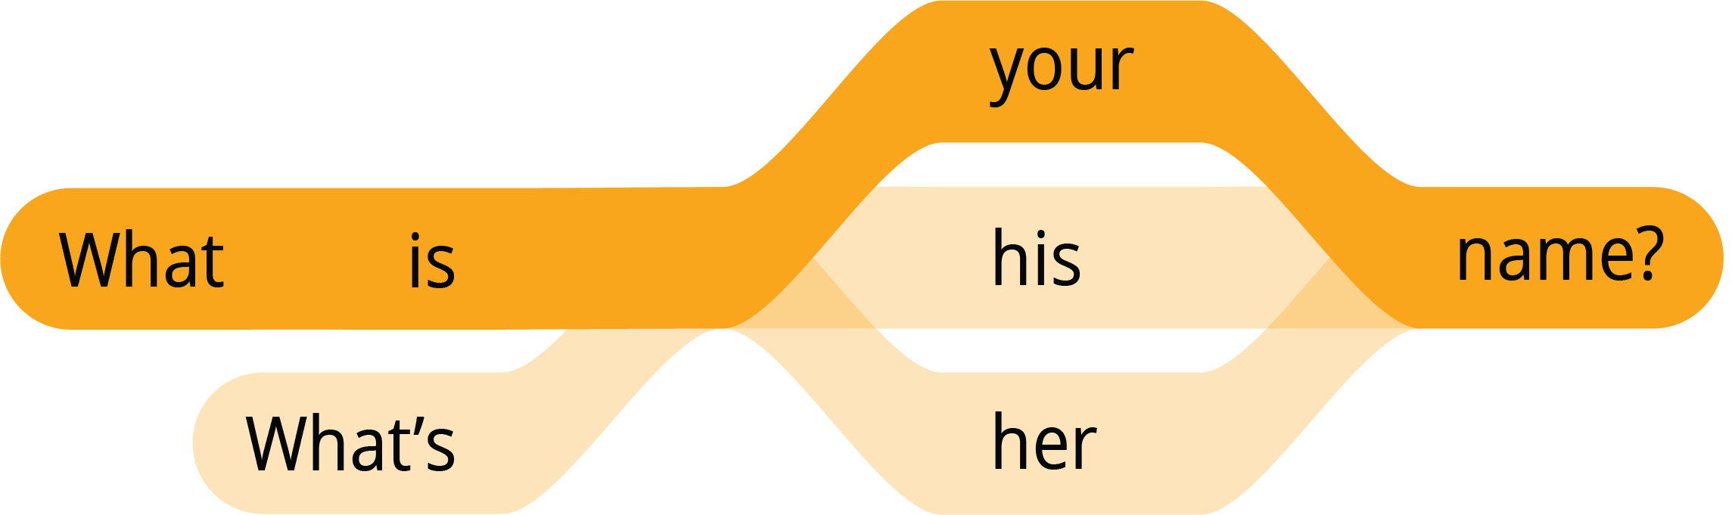
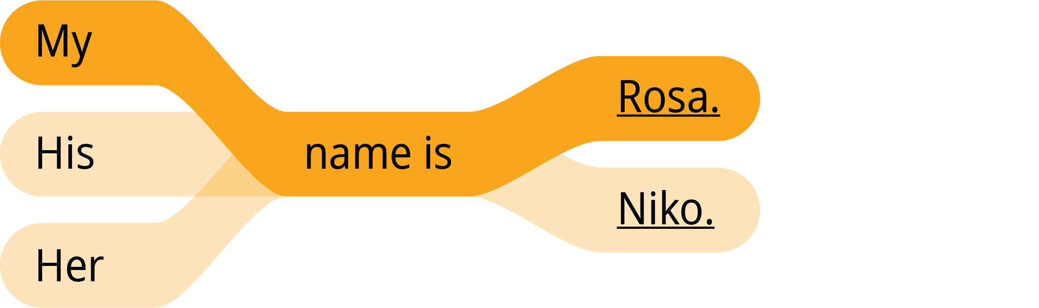
Patterns to Accelerate Learning
Using simple patterns, learners can rapidly create meaningful conversations
Memorize the Vocabulary
hello / hi
name
I / my
you / your
he / his
she / her
yes
no
please
thank you / thanks
What is…?
Nice to meet you.
Practice Pattern 1
Questions
Answers
Notes:
With simple patterns and a few vocabulary words, you can create meaningful conversation.
Example: Unit 1 of EnglishConnect 1, participants learn 90 words and 18 sentence patterns =
200 questions and 3,000 sentences

Slide 16

“EnglishConnect helps me to feel closer to my Heavenly Father, strengthen my faith, and build my testimony. I have developed communication skills that help me lead in the Savior's way.”
Denis Bangala
Democratic Republic of Congo

Slide 17






EnglishConnect expands opportunities for learners to...
IMPROVE EMPLOYMENT
SUCCEED ACADEMICALLY
SERVE
OTHERS

Slide 18


Improve employment

Slide 19
English fluency and income
Learning English can increase employment and earning potential
Day, Jennifer Cheeseman, and Hyon B. Shin. 2005. "How Does Ability To Speak English Affect Earnings?”Census.gov. April. https://www.census.gov/library/working-papers/2005/demo/2005-Day-Shin.html. (Based on income in U.S.; adjusted for 2023 inflation)
Notes:
In the U.S., non-native speakers can see significant employment and earnings gains as they increase their English-language skills.
Most notably as seen in the 20-point percent gains in the “Employed Full Time” column from 41% up to 62%.
Day, Jennifer Cheeseman, and Hyon B. Shin. 2005. "How Does Ability To Speak English Affect Earnings?”
Census.gov. April. https://www.census.gov/library/working-papers/2005/demo/2005-Day-Shin.html.
* Adjusted from 2005 – 2024 using CPI Inflation Calculator of 33.94%, not nominal wage growth

Slide 20

"EnglishConnect has not only taught me English but also responsibility, commitment, and how to be an agentive learner. It has even given me much more confidence than I had before."
Dinah Boiser
Philippines

Slide 21


Succeed academically
Notes:
Each student has a unique path to a degree, and BYU-Pathway provides a way forward for each of them, regardless of economic, cultural, and personal circumstances.

Slide 22

Prepare for BYU-Pathway Worldwide
After earning an EnglishConnect 3 completion certificate, learners can waive the English entrance exam for BYU-Pathway Worldwide and be prepared to be successful in their courses.

Slide 23



Why BYU-Pathway?
BYU-Pathway can help students earn certificates or a degree completely online at a significantly reduced cost!
Its purpose is to help learners become disciples of Jesus Christ who are leaders in their homes, the Church, and their communities.
Increase faith in
Jesus Christ
Get a better job
Save time and money

Slide 24

"Before starting EnglishConnect 3, I tried to enter BYU-Pathway but I didn't pass the language test. A few weeks ago, I tried again. I was so shocked when I received the email saying that I had passed my exam and welcoming me to the program."
Cristina Castellano Botero
Colombia

Slide 25


Serve others

Slide 26

Speak, listen, and learn with others
In EnglishConnect conversation groups, you will teach and learn from others as you:
Improve speaking and listening skills
Learn from mistakes
Make connections
Build confidence

Slide 27
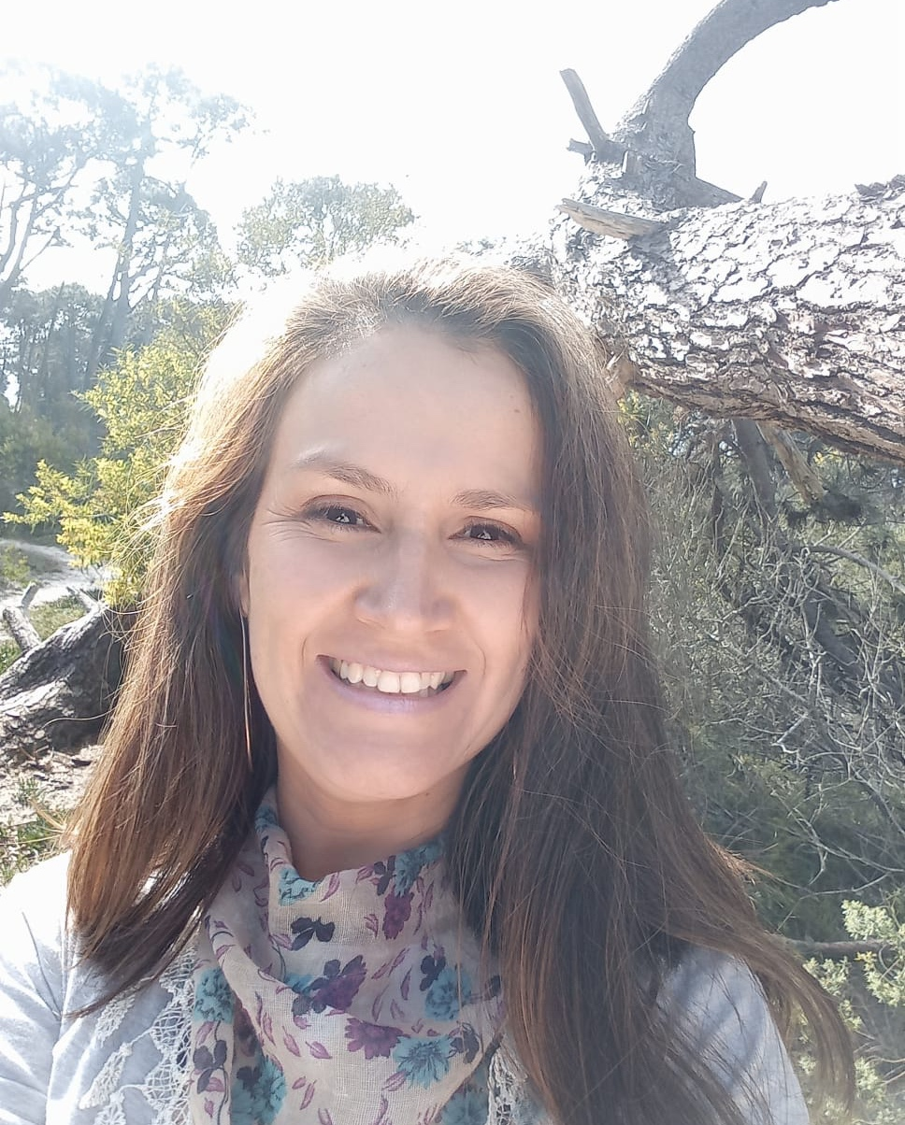
“I have many new friends [from EnglishConnect]. I was afraid to speak in English, but now I feel I can communicate with more people and be understood. I think I will be able to serve others much better.”
Elena Gómez
Uruguay

Slide 28

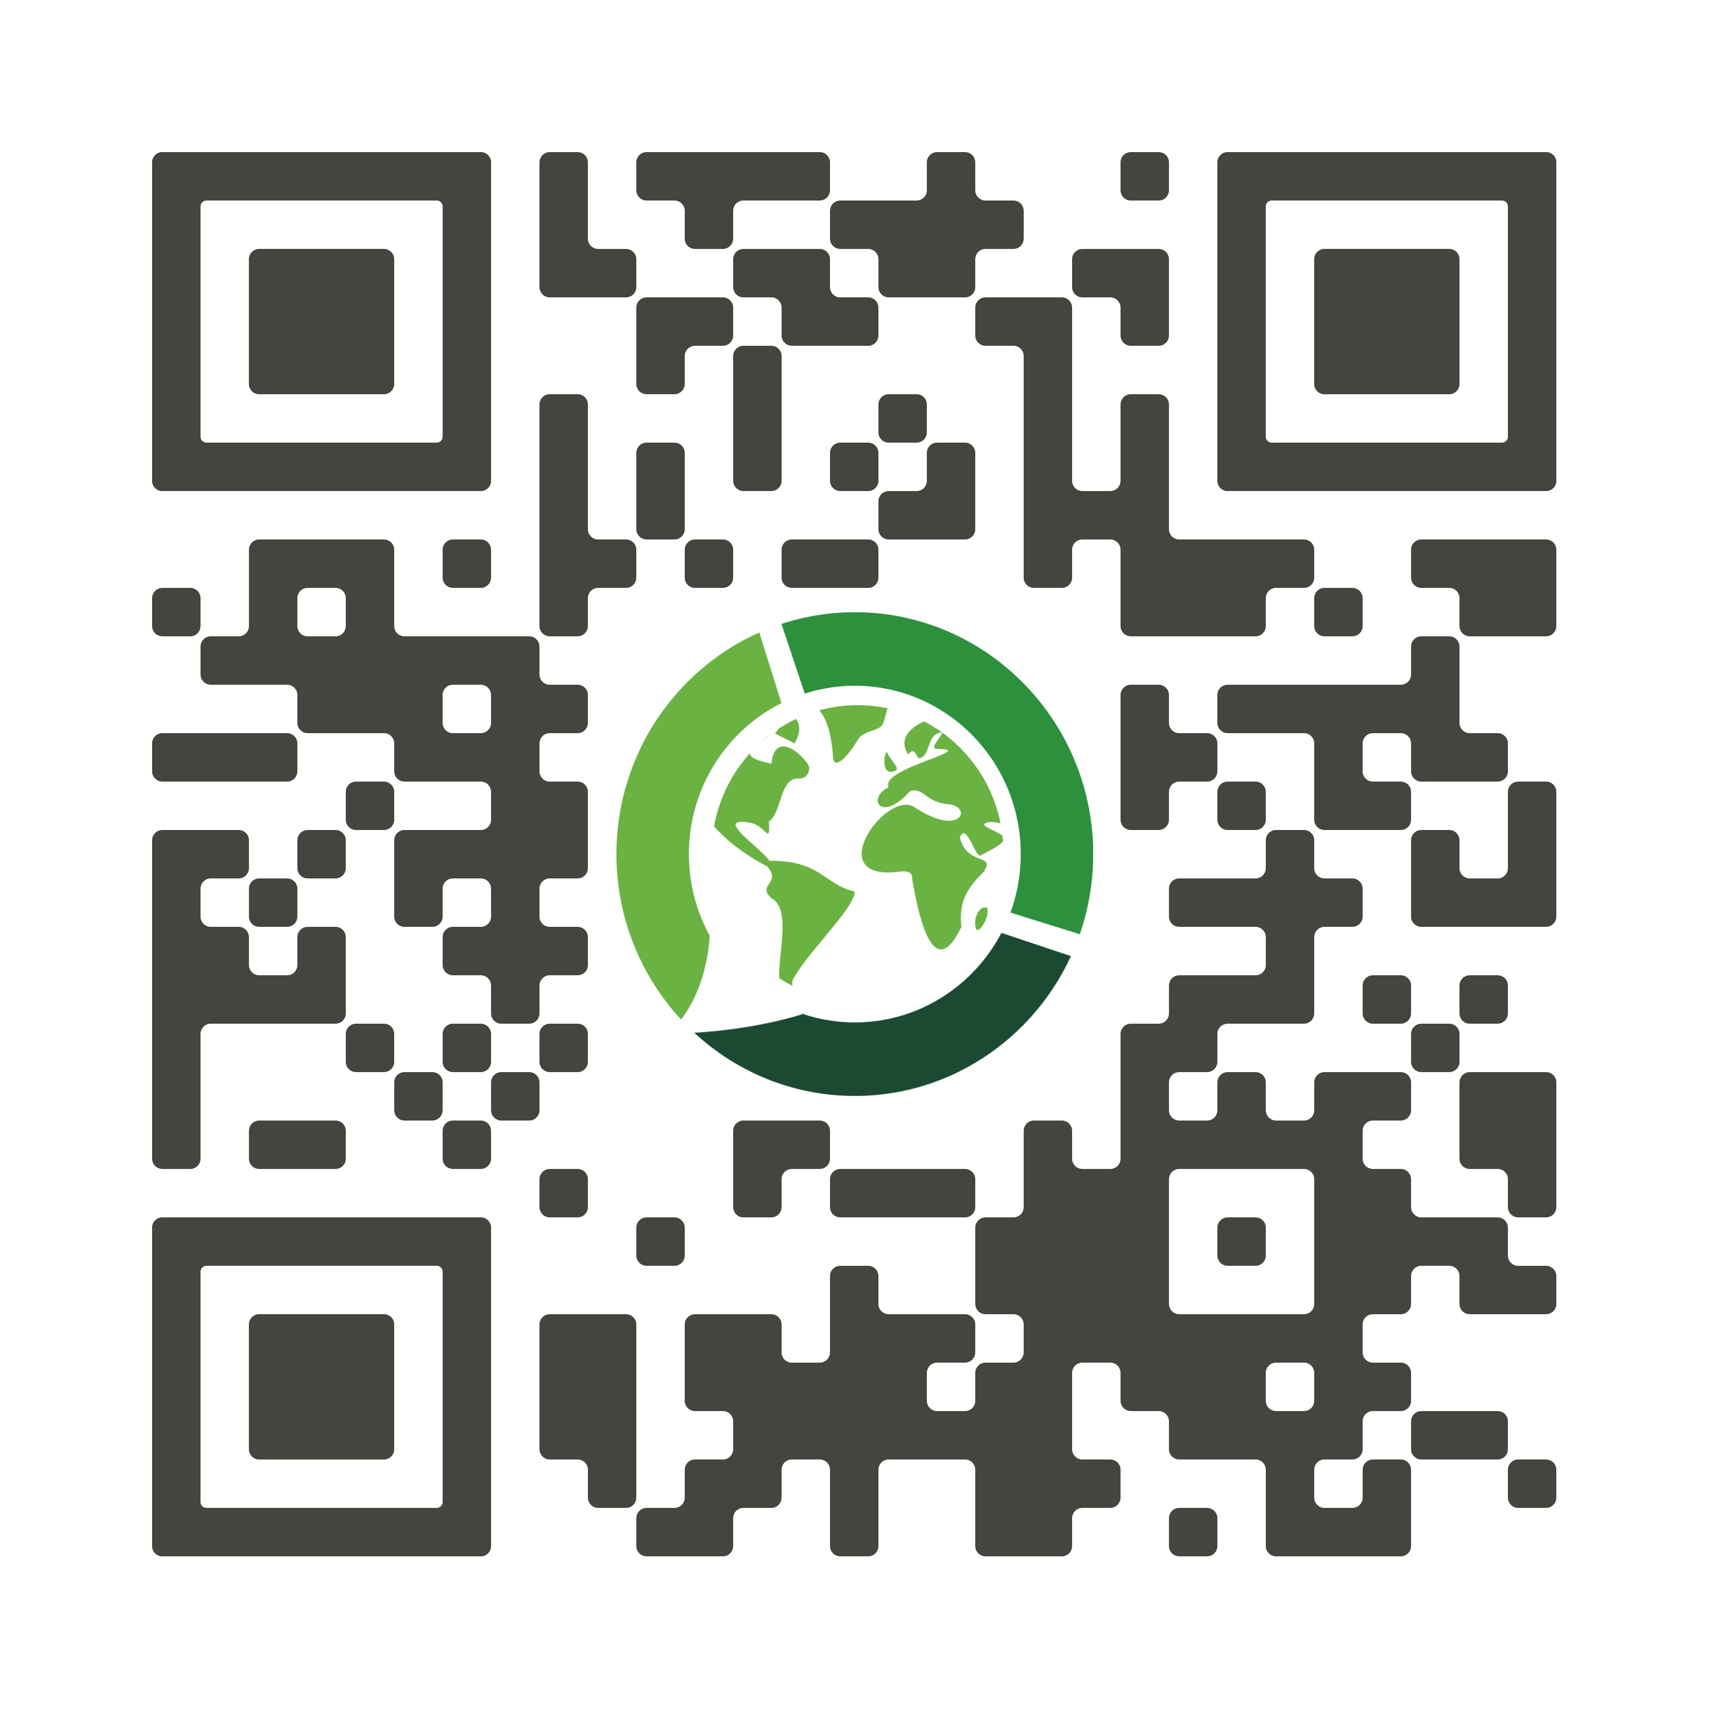
How to get involved
1.
FIND A GROUP NEAR YOU
Visit englishconnect.org/get-started
INVITE OTHERS
Open to the entire community
Available for speakers of all languages
2.
SCAN TO
GET STARTED!
Notes:
Use this slide if you're presenting to prospective students.

Slide 29
englishconnect.org/join

